Slide 1


Multiclass Driver Monitoring System
Leader : Chaitanya Kulkarni
Soham Jadhav
Divyanshu Mishra
Anurag Pawar
Mentor Name: Sarthak Narnor
College Name - PES Modern College of Engineering

Slide 2

Project Outline
Problem Statement and Objectives
Project Overview – Introduction
End Users
Wow Factor in Project
Dataset Description
Modelling/Block Diagram/Flow of Project (Flowchart)
Result/outcomes
Conclusion
Future Perspective
Reference (Datalink, Github, Anyother websites)

Slide 3
Problem Statement
Unsafe and distracted driving behaviors—particularly mobile phone usage while driving—are major contributors to road accidents globally. Manual monitoring is impractical and reactive, while existing automated systems often fail to distinguish between specific distraction types or require extensive computational resources. There is a critical need for an accurate, automated, and scalable system that can classify multiple driver behaviors in real-time using visual data, enabling timely interventions and enhanced road safety.
Scope of the project :
To design an automated system to detect driver behavior
To classify multiple driver activities using a comnination of YoLo Models
To improve road safety by identifying unsafe driving patterns
To build a robust and scalable deep learning solution
Leader : Chaitanya Kulkarni
Soham Jadhav
Divyanshu Mishra
Anurag Pawar
College Name - PES Modern College of Engineering
Leader : Chaitanya Kulkarni
Soham Jadhav
Divyanshu Mishra
Anurag Pawar
College Name - PES Modern College of Engineering

Slide 4
Project Overview - Introduction
Driver behavior monitoring is an important part of intelligent transportation systems aimed at improving road safety. Many road accidents occur due to driver distractions such as mobile phone usage and improper driving actions. With the advancement of deep learning, automated systems can now analyze driver images to recognize unsafe behaviors.
This project presents a Multi-Class Driver Behavior Monitoring System designed to automatically recognize and classify different driver activities from images. The main goal is to enhance road safety by detecting unsafe driving behaviors using deep learning.
The final implementation is based on YOLO object detection models, which are well-suited for real-world scenarios. Additionally, a CNN-based classification model was implemented and evaluated separately for comparative analysis.
- The system processes camera images of drivers and predicts behavior Classes such as:
Safe driving(Seat Belt)
Phone usage
Smoking, Drinking, Drowsiness, Eating and other activities

Slide 5
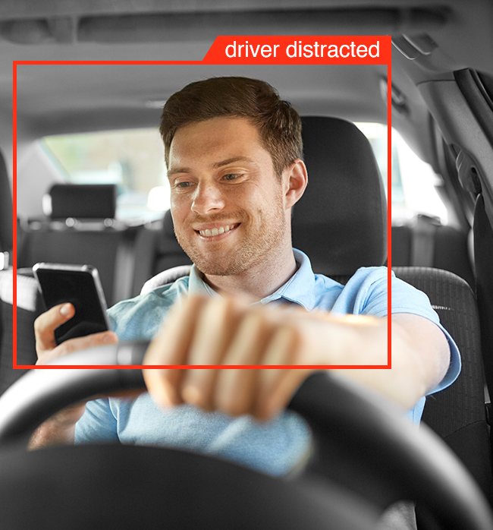
End Users
Stakeholders:
1. Automobile Manufacturers (Advanced Driver Assistance Systems – ADAS)
- Can integrate the system into ADAS to enhance in-vehicle safety
- Helps in detecting driver distraction and fatigue in real time
2. Traffic Safety Authorities
- Supports automated detection of unsafe driving behaviors
- Reduces reliance on manual surveillance and enforcement
3. Insurance Companies
- Enables behavior-based risk assessment of drivers
- Helps in designing dynamic and fair insurance premium models
4. Smart Vehicle and Transportation System Developers
- Can be used as a core module in intelligent and connected vehicles
- Supports integration with smart mobility and transportation platforms

Slide 6
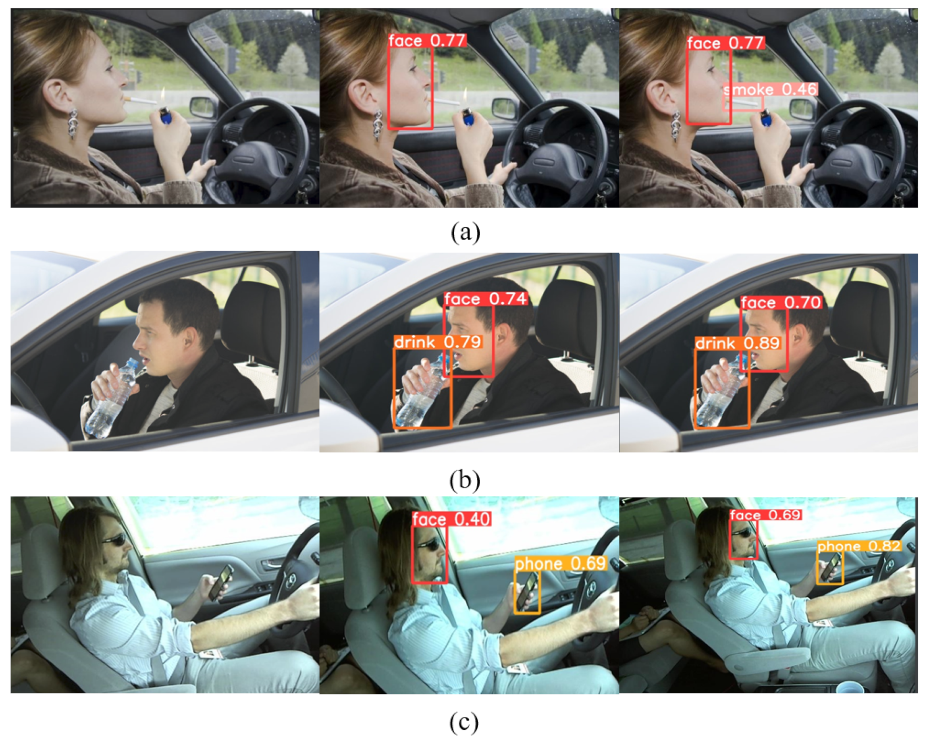
Wow Factors in Project
Key Highlights
Use of two YOLO models running in parallel
Confidence-based selection of predictions
Robust handling of real-world images
CNN model implemented as an additional experiment
Modular and scalable system design
Why It’s Unique
Higher reliability through model comparison
Realistic AI-based monitoring system
Industry-relevant approach

Slide 7
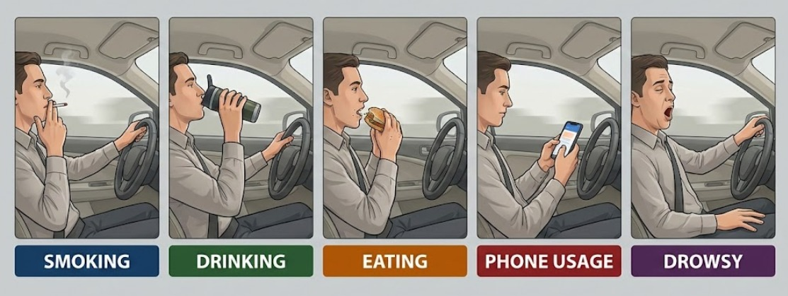
Dataset Description
The dataset used in this project is collected from publicly available sources including Kaggle and Roboflow.
It consists of more than 7,000+ labeled driver images covering multiple driving behaviors.
The dataset includes classes such as
- Smoking
- Seatbelt
- Phone Usage (Texting, Calling)
- Drinking
- Eating
- Drowsy
Images represent real-world driving conditions, with variations in lighting, camera angles, and driver postures.
The data is organized and annotated in YOLO format, enabling efficient training and evaluation of object detection models.

Slide 8
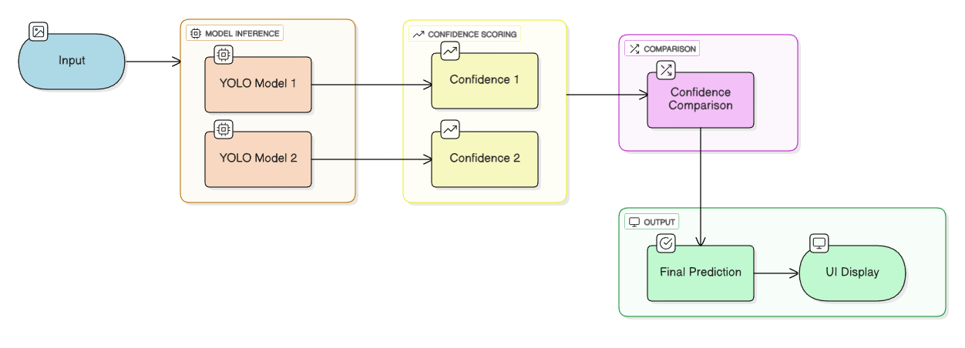
Modelling/Block Diagram/Flow of Project

Slide 9
Technology Stack
Programming Language: Python
Deep Learning Models: YOLO (Object Detection), CNN (Image Classification – experimental)
Frameworks & Libraries: TensorFlow, Keras, OpenCV, NumPy, Ultralytics
Model Development Environment: Google Colab
Dataset Source: Kaggle (Multi-Class Driver Behavior Image Dataset), Roboflow
Visualization & Evaluation: Matplotlib, Seaborn
User Interface (UI): Web-based UI and Flask (for displaying final prediction)
Model Overview :
1.YOLO (You Only Look Once)
- YOLO is a single-stage object detection algorithm that detects multiple objects and their locations in real time.
- It processes the entire image in one forward pass, making it highly suitable for real-time driver monitoring systems.
- The use of dual YOLO models improves reliability through confidence-based prediction selection
- Mean average precision :
map50: 0.9134820409250091 , map50-95: 0.6636814530384787
2. CNN (Convolutional Neural Network)
- CNN is a deep learning model specialized for image classification and feature extraction.
- In this project, a CNN-based model was implemented as an experimental approach to compare classification--based performance with YOLO detection results.

Slide 10
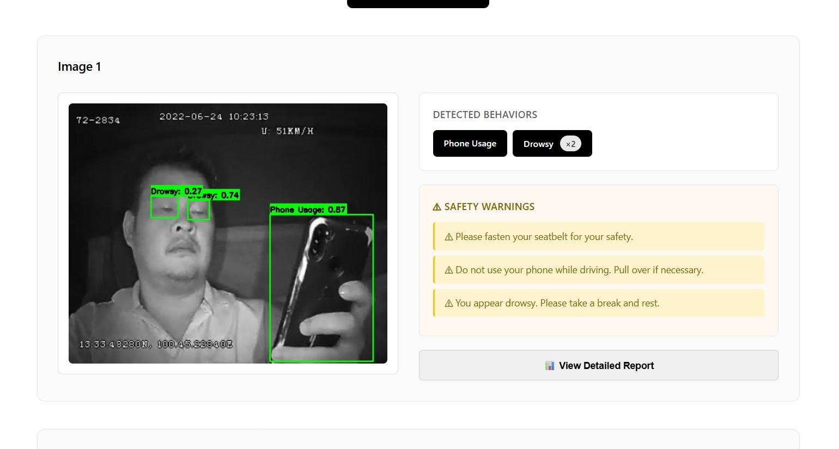
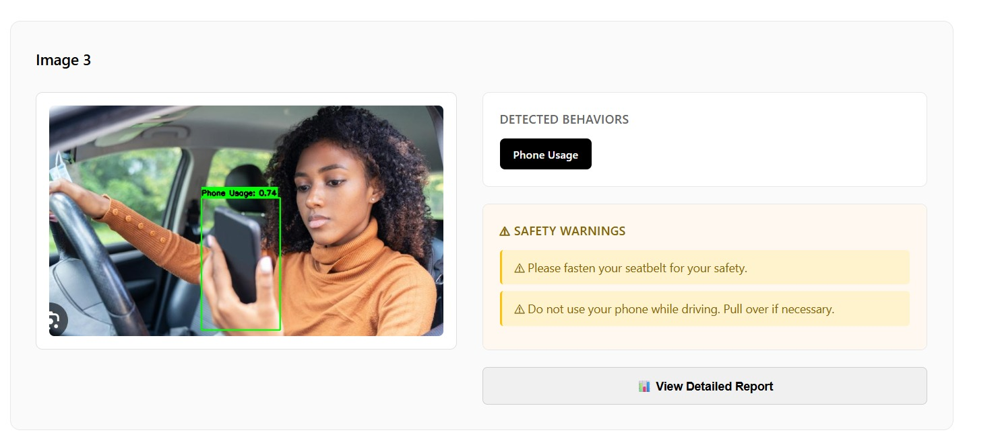
Result/Outcomes

Slide 11
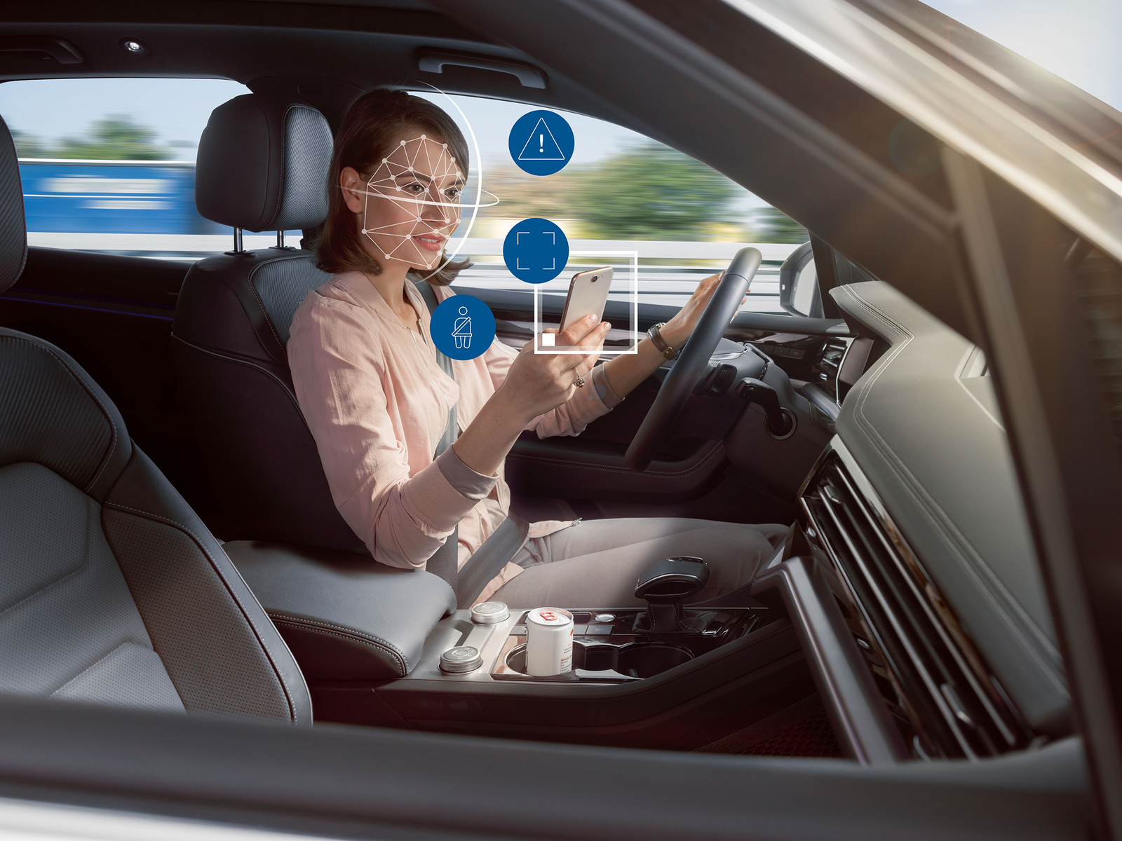
Future Perspective
Integration of the system with real-time video streams for continuous driver monitoring instead of single-image analysis.
Fusion of additional sensor data (steering patterns, speed, vehicle telemetry) with vision-based models.
Adaptive confidence-weighted model fusion, where model selection dynamically changes based on driving conditions.
Use of larger and more diverse datasets to improve generalization across lighting and camera angles.
Incorporation of temporal models (such as LSTM or 3D CNNs) to analyze driver behavior over time.
Integration with ADAS and alert systems for real-time driver warnings.

Slide 12
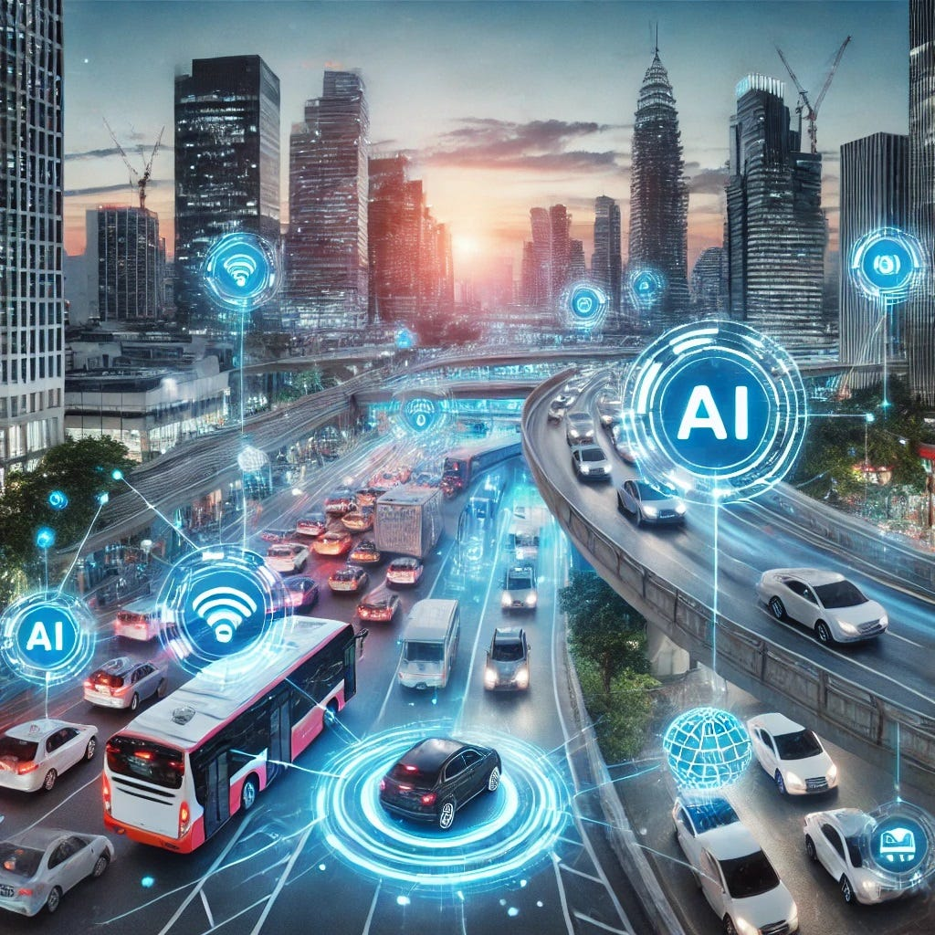
Conclusion
This project demonstrates the effectiveness of deep learning in understanding complex driver behaviors through visual analysis. By employing a confidence-based dual-YOLO inference strategy, the system enhances prediction reliability beyond single-model approaches. The implementation highlights how model diversity and decision-level fusion can improve robustness in real-world scenarios. Additionally, the separate evaluation of a CNN model provides valuable insights into the comparative strengths of classification and detection-based methods, reinforcing the practical relevance of the proposed system.

Slide 13
References
Datasets
- Kaggle – Multi-Class Driver Behavior Image Dataset
- Roboflow - https://universe.roboflow.com/search?q=class%3Aseatbelt
- Mendeley Data - https://data.mendeley.com/datasets/mzb4b6dff3/1
2. Documentation of Library Used:
- Libraries Used: TensorFlow, Keras, OpenCV, NumPy, Matplotlib
3. Related Research:
- Distracted Driver Detection (Kaggle Competition)
- Deep Learning for Autonomous Driving (arXiv papers)
4. GitHub Repository Link
- https://github.com/AlbatrossC/Driver-Monitoring-System.git

Slide 14
Thank You
Notes:
Thank You !!

